Slide 1
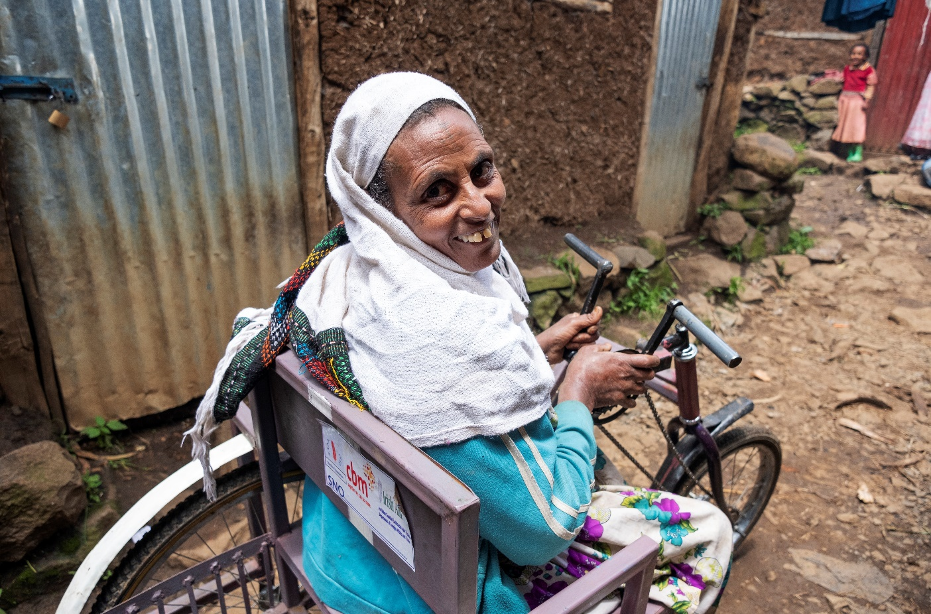
Women and Girls with Disabilities
CBM\Hayduk

Slide 2
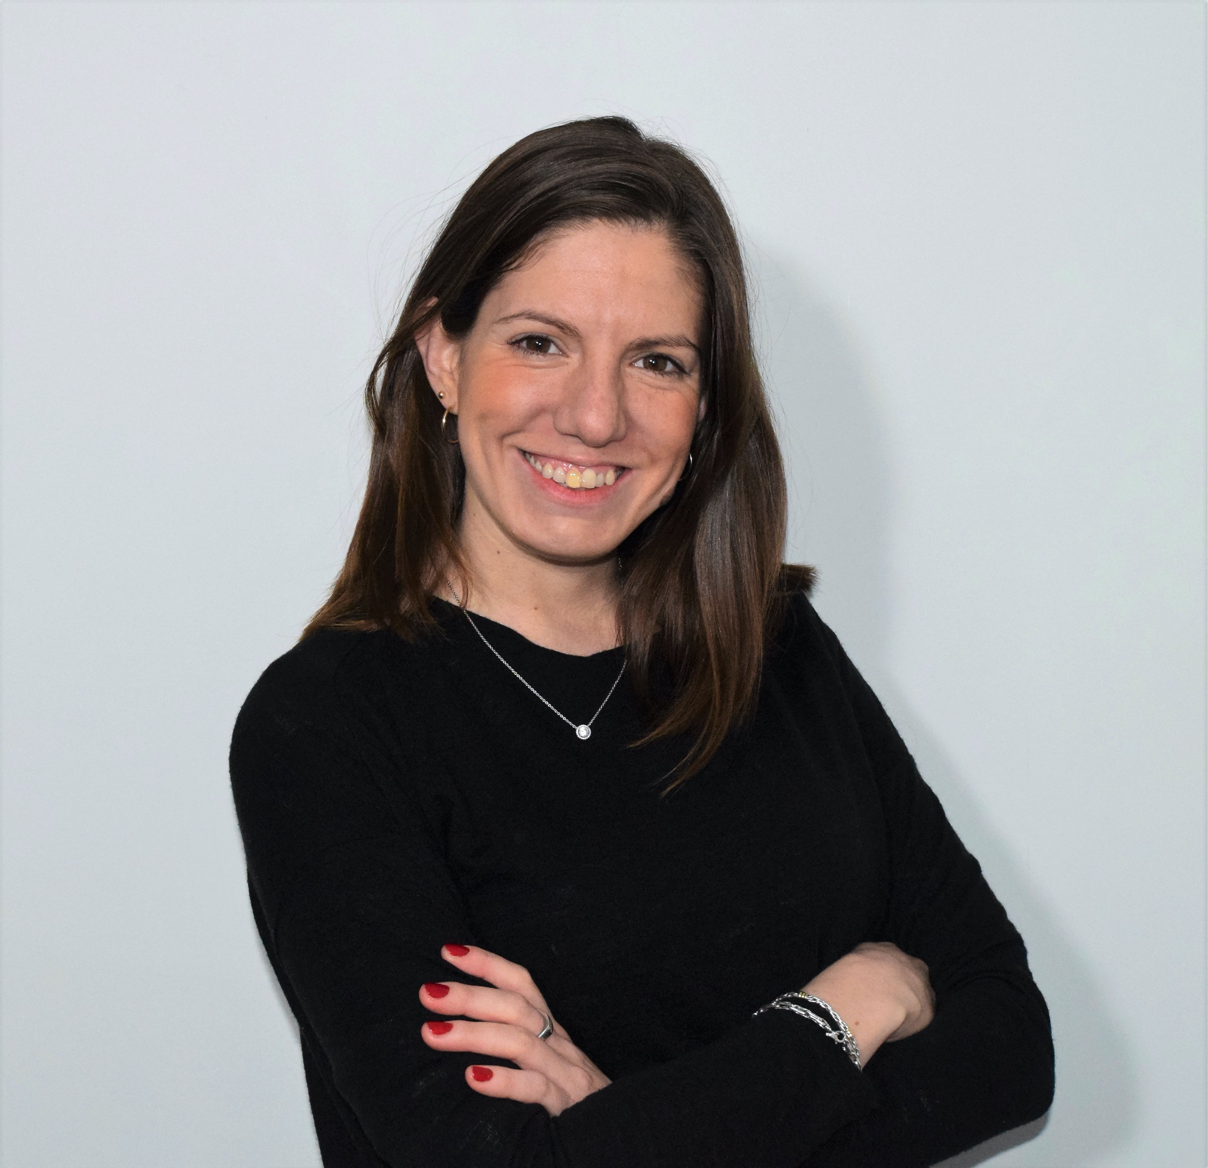
Who are your presenters today?
Dr. Mary Keogh, Director,
Disability Inclusive Development, CBM
Email: Mary.Keogh@cbm.org
Maria Gonzalez, MSc in Global Health, Programmes and Advocacy Advisor, CBM Ireland

Slide 3
What we will cover in today’s webinar
Who are women and girls with disabilities?
How are women and girls with disabilities impacted by discrimination?
What are the key issues impacting women and girls with disabilities
How are women and girls with disabilities protected by international law
What steps have development frameworks such as the SDGs taken to ensure the issues that affect women and girls with disabilities are addressed
In our own work, what steps can we take to improve, policies and programmes?
Resources

Slide 4
1. Who are we?
….Women with disabilities are a diverse group. We are indigenous women, we are young girls, and older women. We are lesbian, bi-sexual, transgender women and intersex persons.
We are refugee women, migrant, asylum seeker and internally displaced women, and women in detention (hospitals, residential institutions, juvenile or correctional facilities, prisons). We are women who come from all walks of life, we are women who live in poverty. We are women from different ethnic, religious and racial backgrounds and we are women with different types of disabilities….
Notes:
This description is taken from General comment no 3 of the CRPD committee (para 5)

Slide 5
’’Nothing About us Without Us’’
https://www.youtube.com/watch?v=wsfuvqyW2M0

Slide 6
2. Multiple Discrimination and its impact on women and girls with disabilities
Women and girls with disabilities face discrimination & exclusion on a number of grounds:
Disability discrimination due to having a disability
Discrimination on the grounds of being a woman or girl
In many countries discrimination because of living in poverty
This can be often referred to as double or triple discrimination

Slide 7
Intersectional discrimination – women and girls with disabilities at the crossroads of intersecting identities
“I think it’s important to look at intersectionality
of identity. I believe we focus too much
on just one … in fact we are never just one
thing. I identify myself as not just a woman,
I identify myself as a woman who is black,
from the south and Deaf” – Megan Shanks, US

Slide 8
Intersectional discrimination
The concept of intersectional discrimination recognises that individuals do not experience discrimination as members of a homogenous group but, rather, as individuals with multidimensional layers of identities, statuses and life circumstances.
It acknowledges the lived realities and experiences of heightened disadvantage of individuals caused by multiple and intersecting forms of discrimination, which requires targeted measures to be taken with respect to disaggregated data collection, consultation, policymaking, the enforceability of non-discrimination policies and the provision of effective remedies.
Notes:
CRPD General Comment

Slide 9
3. Key issues/barriers impacting women with disabilities – Economic, Social and Cultural Rights (1)
Access to Education:
Women and girls with disabilities are recognized as faring less well than boys with disabilities and women and girls without disabilities in accessing education and training
Some of the barriers faced:
Lack of access to safe and secure transport to take girls and women with disabilities to school and training,
Inaccessible classrooms and training spaces and water and sanitation facilities. Not having access to water and sanitation facilities for example can mean a young woman with a disability may drop out of school
The cost of attending school can also be a barrier for girls with disabilities, particularly girls living in poverty. This can be further compounded by negatively held views about the value of educating girls with disabilities
Notes:
Data from the World Report on Disability highlight that 50.6% of males with a disability have completed primary school, compared with 61.3% of males without a disability. For females with a disability the report notes that 41.7% completed primary school compared to 52.9% of females without a disability

Slide 10
Key issues/barriers impacting women with disabilities – Economic, Social and Cultural Rights (2)
Economic Empowerment/Access to employment or livelihood opportunities:
Available data at a global level highlights that women with disabilities have lower participation rates in the labor market in comparison to men with disabilities and women without disabilities.
Some of the barriers faced:
barriers such as negative attitudes, misperceptions about the abilities of women with disabilities and lack of accessibility in workplaces and transport to work all contribute to their exclusion from opportunities for economic empowerment
Notes:
The World Report on Disability highlights that employment rates for women with disabilities are lower than men with disabilities and women without disabilities. 19.6 per cent for women with disabilities and 52.8 per cent for men and 29.9 per cent for women without disabilities

Slide 11
Key issues/barriers impacting women with disabilities – Economic, Social and Cultural Rights (3)
Access to Health/Sexual Reproductive Rights:
Global comparable data on health outcomes for women and girls with disabilities is limited there is some evidence from that highlights how women with disabilities rate their health status as lower than women without disabilities and also worse than men with disabilities
Some of the barriers faced:
Lack of access to healthcare due to lack of inaccessible equipment for women’s healthcare such as mammograms.
Negative attitudes by healthcare staff when it comes to sexual and reproductive health care and also during child-birth.

Slide 12
Key issues impacting women with disabilities – Civil and political rights (3)
Violence against women is recognised as a particular human rights violation that women and girls with disabilities are at greater risk of than their non-disabled peers: “… when gender, disability and other factors intersect – the violence against [women with disabilities] takes on unique forms, has unique causes and results in unique consequences”.
Barriers faced by women with disabilities
Information about abusive behavior, their rights, violence against women services and legal recourse may not be available to women with disabilities
A lack of knowledge and understanding of the specific situations of women with disabilities on the part of legal representatives, police and other justice system administrators can leave women with disabilities more exposed to future violence when they expose abuse and seek help

Slide 13
4. How are women and girls with disabilities protected by international law? (1)
The inclusion of women and girls with disabilities in international normative frameworks has evolved over a number of decades.
The inclusion of women and girls with disabilities in the CRPD was largely due to demands of the disabled women’s movement and women with disabilities who played a key role in the negotiation of the CRPD
The CRPD recognises the need to take a gender mainstreaming approach to the inclusion of women and girls with disabilities and requires that State Parties take active measures for ensuring gender and disability equality
The CRPD also includes a standalone article – Article 6, which specifically addresses measures State Parties must take to ensure women with disabilities are protected from multiple discrimination and can enjoy their human rights and fundamental freedoms on an equal basis with others, for example, men with disabilities and women without disabilities. Article 6 is interpreted as a crosscutting article and should be taken into consideration when implementing all of the rights contained in the CRPD

Slide 14
How are women and girls with disabilities protected by international law? (2)
Women with disabilities are also protected by norms protecting and advancing the rights of women, such as the Convention on the Elimination of All Forms of Discrimination Against Women (CEDAW)
Girls with disabilities are protected by both CEDAW and the CRPD

Slide 15
5. How have development frameworks included women and girls with disabilities?
Gender equality for persons with disabilities is now beginning to emerge on the disability inclusive development agenda and donors and policy makers are beginning to realise that international development policy and programme work on disability inclusive development needs to address the intersection of gender and disability
The SDGs and particularly Goal 5, which focuses on Gender Equality and the empowerment of women and girls, has a key role in creating opportunities for women and girls with disabilities to fulfill their full potential.
Notes:
End discrimination against all women and girls everywhere
This is particularly relevant to women and girls with disabilities. In comparison to men
with disabilities and women without disabilities, women and girls with disabilities have
lower education completion rates, are less likely to be employed and are more at risk
of living in poverty. National policies and frameworks that are developed as a result
of the SDGs must include women and girls with disabilities if discrimination against all
women and girls is to be achieved.
Eliminate all forms of violence and harmful practices against all women
Women with disabilities are at heightened risk of violence, exploitation and abuse
compared to women without disabilities. Measures taken to implement this target
must be inclusive of women with disabilities.
Recognise and value unpaid care work
This is an important point for both women and men with disabilities who require
personal assistance/care assistance and needs to be adequately resourced by
governments. Women who make up the majority of the caring/personal assistance
workforce providing this support should be paid fairly for their work.
We must also be careful to include sign languages interpretations as a required
resource. Sign language interpreters are not officially identified as personal assistants
but equally important for D/deaf and hard of hearing people to be part of the
workforce. We also need to make sure that personal assistance is not limited to
women and girls with mobility disabilities as women and girls with intellectual and
psychosocial disabilities benefit from personal assistance.
Reform legislative and policy blocks that prevent women having equal rights to
economic resources
Linked with the above statement about women with disabilities at risk of living in
poverty, some of the factors that contribute to this include; laws and policies that
prevent women with disabilities having control over their resources. For example,
outdated legal capacity laws and prejudicial attitudes which deny women with
disabilities the opportunities to have their own bank accounts or prevents them from
getting access to micro-credit for livelihood opportunities. Measures taken to reform
laws to enable equal rights to resources must also include women with disabilities.
Enhance the use of enabling technology
Technology and assistive devices are key enablers for women and men with
disabilities. Access to assistive aids and devices can make a difference in the lives of
women and men with disabilities, technology also has a key role to play in creating
inclusion.
Ensure participation and leadership in decision-making
Women with disabilities typically have not been in leadership positions within the
government and public sector, the private sector, disability or gender movements.
Ensure universal access to sexual and reproductive health and reproductive rights
Women and girls with disabilities face negative attitudes by society related to the
intersection of disability and gender and these impact on the enjoyment of sexual and
reproductive health and rights, and the right to a found a family.

Slide 16
6. Lets build on the progress – start with the personal
Personal
Support efforts to develop leadership for women with disabilities
Women with disabilities have generally had less access to leadership opportunities and only a small number of women with disabilities currently have leadership positions in development organisations and NGOs

Slide 17
Support movement building
Political
Create a strong global voice of women with disabilities inclusive of all women with disabilities. The voices of women with disabilities are beginning to be heard through organisations such as ‘Women Enabled’, Mobility International but more needs to be done.
Develop joint disability and gender advocacy alliances. The gender and disability movement have a number of key issues common to both, combined advocacy on areas such as government support to independent living and care would be beneficial to both movements.

Slide 18
Commit to Inclusion in a Policy
Policy
Ensure mainstream, gender specific and disability specific development policies and programmes are inclusive of women, men, girls and boys with disabilities.
It is a two-way street, disability policies and programmes should not ignore gender equality and equally gender policies and programmes should be
inclusive of disability rights.

Slide 19
7. Resources
The Personal, The Political, The Policy
CBM submission on women and girls with disabilities to CRPD Committee
Five Perspectives on Gender Equality
https://www.endthecycle.info/resources/women/
Disability Rights, Gender, and Development. A Resource Tool for Action
https://www.awid.org/sites/default/files/atoms/files/intersectionality_a_tool_for_gender_and_economic_justice.pdf
Global Disabled Women's Rights Advocacy Report
Women's and Disability Rights in the Middle East
Pacific Sisters with Disabilities

Slide 20
Thank you for listening!
Questions

Slide 21
For further information on CBM Disability Inclusive Development:
Mary.Keogh@cbm.org
Website: www.cbm.org
CBM\Hayduk

